Slide 1
Software Development Life Cycle(SDLC)
SDLC is to develop a product in a systematic way and deliver a high quality product
Requirement
Gathering&analysis
Design
Maintanence
Deployment
coding
testing

Slide 2
Requirements gathering&analysis
Business analyst collects the requirements from the customers /clients as per the client’s business needs and document the requirements in the Software requirement specifications(SRS)
business requirements specification (BRS)
Customer requirement specification (CRS)

Slide 3
analysis
This is to define and document the product requirements and get them approved by the customer .
This is done through software requirements specification (SRS).
Project manager ,Business analysts and senior members of the team are the key people involved .

Slide 4
Design
It has 2 steps,
High level design (HLD)
It gives the architecture of the software product
It is done by architects and senior developers
Low level design (LLD)
It describes how each and every feature in the product should work.
It is done by senior developers .

Slide 5
Coding
This is the phase where we start building the software and start writing code for the product.
Developers of all levels (seniors, juniors ,fresher's) are involved .
The outcome of this phase is source code document (SCD) and the product

Slide 6
Testing
Test thoroughly for different defects.
Either test manually or using automation tools.
Once the QA makes sure that the software is error free, then it goes to the next stage which is implementation.

Slide 7
Deployment
After testing the product is delivered /deployed to customer or first UAT(user acceptance testing)is done depending on the customers expectation.
It is done by the deployment/ implementation engineers.
If the customer finds the application as expected then sign off is provided by the customer to go live.

Slide 8
maintanence
After the deployment of a product on the production environment ,maintance of the product ie,if any issue comes up & needs to be fixed or any enhancement is to be done is taken care by the developers.
Maintenance should be done as per SLA (service level agreement ).

Slide 9
Types of SDLC models
Waterfall Model
V-Shaped Model
Iterative Model
Incremental model
Spiral Model
Prototype Model
Agile Model

Slide 10
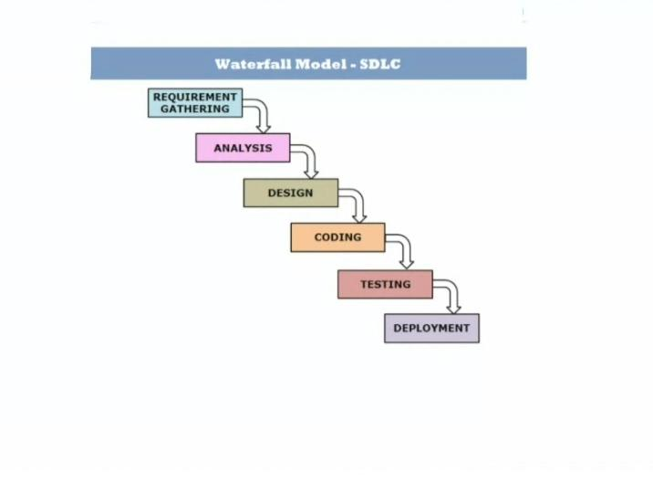
Waterfall Model

Slide 11
Waterfall Model
It is a traditional model in which progress is seen as flowing downwards like a waterfall.
Every next phase is began only once the goal of previous phase is completed.
Preferred in project where quality is important than schedule and cost.
Suitable for projects where requirement will not change.

Slide 12
It is also known as linear sequential model.
Advantage
Simple and easy to use
Best for small projects with well written requirements.
Disadvantage
Defect were being found too late in the life cycle
Cannot adopt any new changes in the requirements

Slide 13
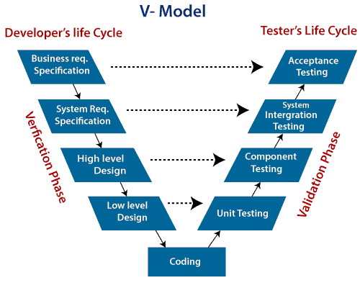
V-Shaped Model

Slide 14
The V-model is a type of SDLC model where process executes in a sequential manner in V-shape.
It is also known as Verification and Validation model.
In this model verification and validation goes hand in hand.ie,development &testing goes parallel.

Slide 15
V model and waterfall model are the same except that the test planning & test start at an early stage in v model.
Advantage
Suitable for small projects
Testing starts from requirement phase
Disadvantage
Not a good option if requirement changes frequently.

Slide 16
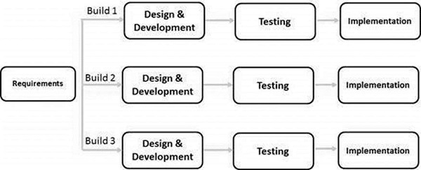
INCREMENTAL model

Slide 17
In incremental model the whole requirement is divided into various builds. Multiple development cycles take place here,
Cycles are divided up into smaller, more easily managed modules.
In this model, each module passes through the requirements, design, implementation and testing phases.
A working version of software is produced during the first module, so you have working software early on during the software life cycle.
Each subsequent release of the module adds function to the previous release. The process continues till the complete system is achieved.

Slide 18
Advantages:-
The software will be generated quickly during the software life cycle
It is flexible and less expensive to change requirements and scope
Disadvantages:-
It requires a good planning designing

Slide 19
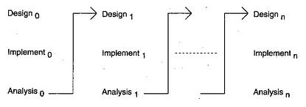
ITERATIVE model

Slide 20
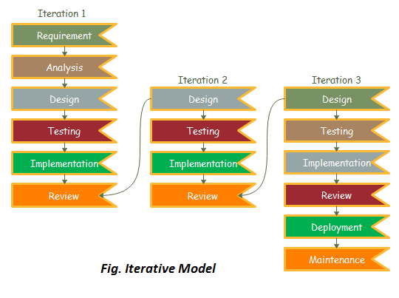
ITERATIVE model

Slide 21
An iterative model does not attempt to start with a full specification of requirements. Instead, development begins by specifying and implementing just part of the software, which can then be reviewed in order to identify further requirements.
This process is then repeated, producing a new version of the software for each cycle of the model.

Slide 22
Advantages:-
Generates working software quickly and early during the software life cycle.
More flexible – less costly to change scope and requirements.
Easier to test and debug during a smaller iteration.
Disadvantages:-
More resources may be required.
It is not suitable for smaller projects.

Slide 23
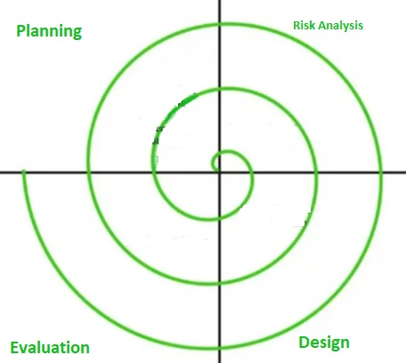
Spiral Model

Slide 24
In it’s diagrammatic representation ,it looks like a spiral with many loops ,that’s the reason it’s called as spiral.
Each loop of the spiral is called a phase of the software development process.This model has capability to handle risks.
It working is an iterative nature.
Every iteration starts with planning and end with product evaluation by client.

Slide 25
Phases of Spiral Model
Planning Phase- Requirement gathering ,cost estimation, resource.
Risk Analysis Phase- Strength and weakness of the project.
Design Phase- Coding -Internal testing and deployment.
Evaluation Phase-
Client evaluation to get the feedback

Slide 26
Advantage
Software is produced early in the software life cycle.
It is good for large and complex projects.
Risk handling is one of the important advantage of spiral model.it is best development model to follow due to the risk analysis &risk handling at every phase.
Good for customer satisfaction

Slide 27
Disadvantage
Much more complex than other models .process is complex
End of the project may not be known early.

Slide 28
Agile model
Agile is a software development methodology based on iterative and incremental development.
Agile:Able to move quickly and easily
The requirements are decomposed into many small parts that can be incrementally developed.
The division of the entire project in to smaller parts helps to minimize the project risk and to reduce the overall project delivery time requirements.
User can add requirement at any stage.
Agile methodology work in each iteration and release a working software at the end of each iteration.
In the Agile model in software testing, both development and testing activities are concurrent, unlike the Waterfall model.

Slide 29
Advantages
Deployment of the software is quicker
Can adapt to rapidly changing requirements and respond faster.
Customer interaction and satisfaction is done in each iteration.
Disadvantages
Depends heavily on customer interaction
.

Slide 30
Prototype Model
In this model a prototype is made first and based on it final product is developed.
A prototype is a model or a program which is not based on strict planning, but is an early approximation of the final product or software system.
A prototype acts as a sample to test the process. From this sample we learn and try to build a better final product.
Please note that this prototype may or may not be completely different from the final system we are trying to develop.

Slide 31
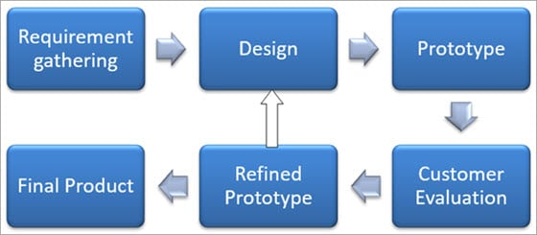
1: Requirements gathering and analysis
A prototyping model starts with requirement analysis. In this phase, the requirements of the system are defined in detail. During the process, the users of the system are interviewed to know what is their expectation from the system.

Slide 32
.
design
The second phase is a preliminary design or a quick design. In this stage, a simple design of the system is created. However, it is not a complete design.
Build a Prototype
In this phase, an actual prototype is designed based on the information gathered from quick design. It is a small working model of the required system.

Slide 33
Initial user evaluation
In this stage, the proposed system is presented to the client for an initial evaluation. It helps to find out the strength and weakness of the working model. Comment and suggestion are collected from the customer and provided to the developer.

Slide 34
Refining prototype
If the user is not happy with the current prototype, you need to refine the prototype according to the user’s feedback and suggestions.
Implement Product and Maintain
Once the final system is developed based on the final prototype, it is thoroughly tested and deployed to production.

